Slide 1
DIENCEPHALON
DR OSO O.A

Slide 2
OUTLINE
Introduction
Anatomical location
Thalamus
Hypothalamus
Epithalamus
Subthalamus
Conclusion

Slide 3
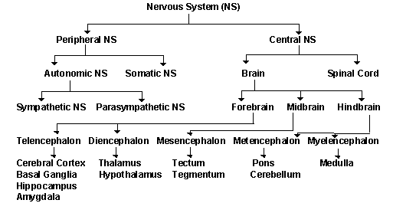

Slide 4
INTRODUCTION
The diencephalon is the central part of the forebrain, located between the cerebral hemispheres and the midbrain
Divided into: Thalamus, Hypothalamus, Epithalamus, Subthalamus
The third ventricle may be regarded as the cavity of the diencephalon
Functions as a major relay and integration centre for sensory and motor pathways

Slide 5
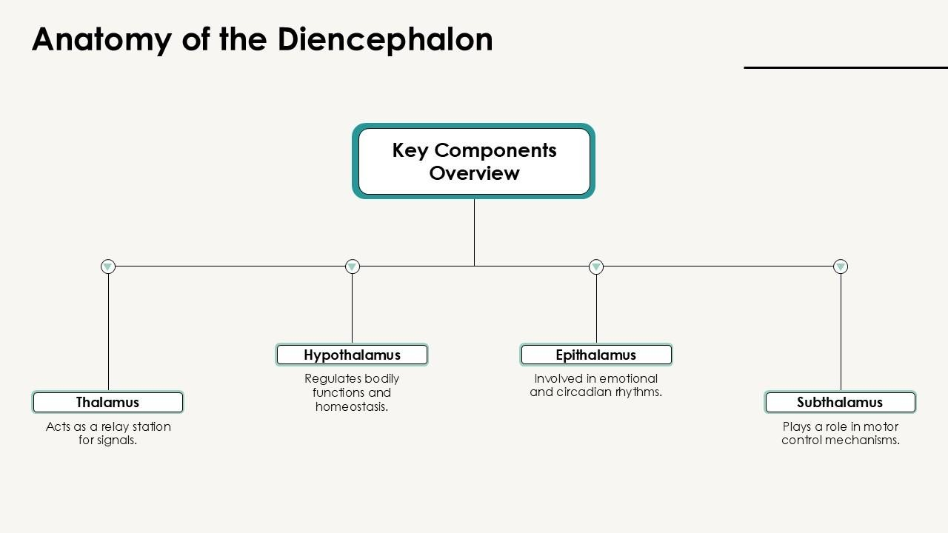

Slide 6
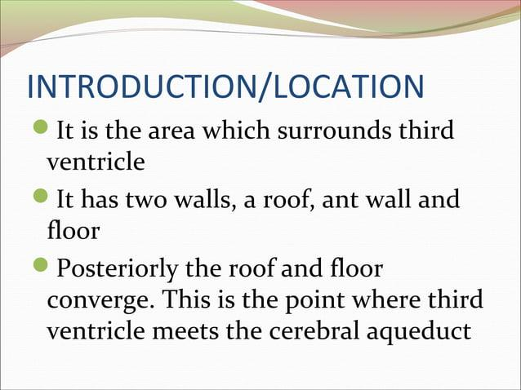

Slide 7
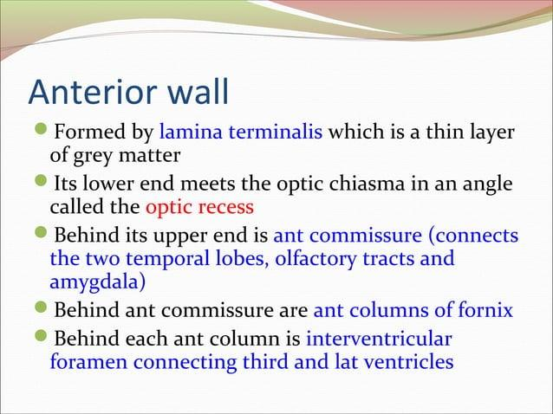

Slide 8
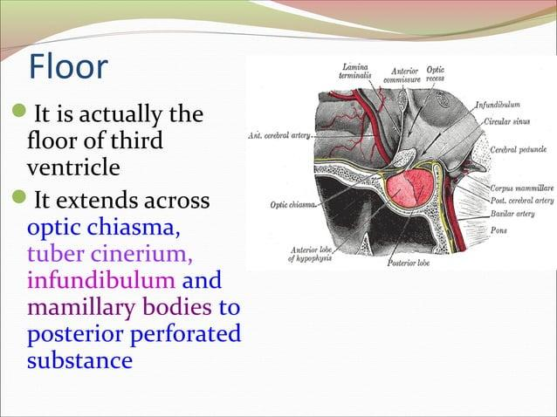

Slide 9
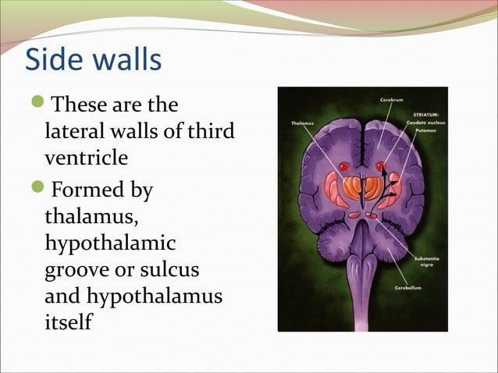

Slide 10
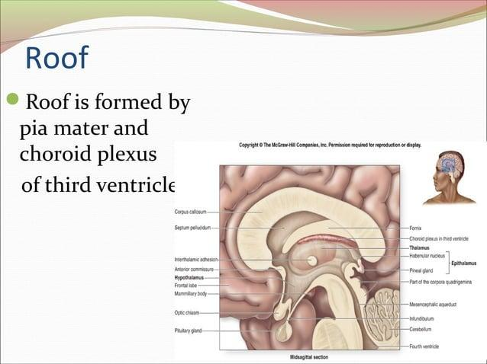

Slide 11
PARTS OF DIENCEPHALON
Thalamus
Hypothalamus
Epithalamus
Subthalamus

Slide 12
THALAMUS: Structure and Nuclei
The thalamus is the largest mass of grey matter of the diencephalon that is laterally related to the third ventricle
The symmetrical halves of this midline structure are located between the cerebral cortices and the midbrain
It has an anterior and a posterior pole, as well as superior, inferior, medial and lateral surfaces
Its superior part is covered by a thin layer of white matter called the stratum zonale and its lateral surface is covered by a similar layer called the external medullary lamina.

Slide 13
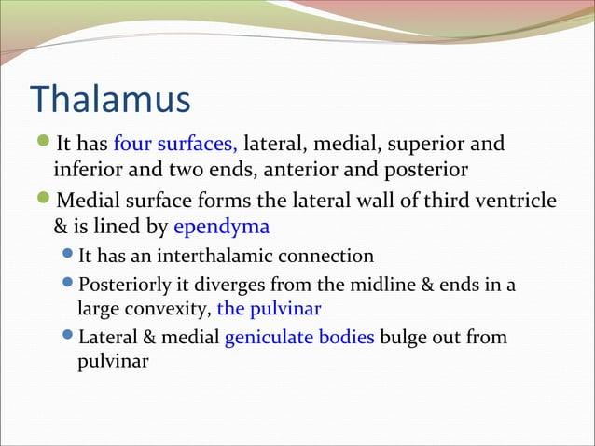

Slide 14
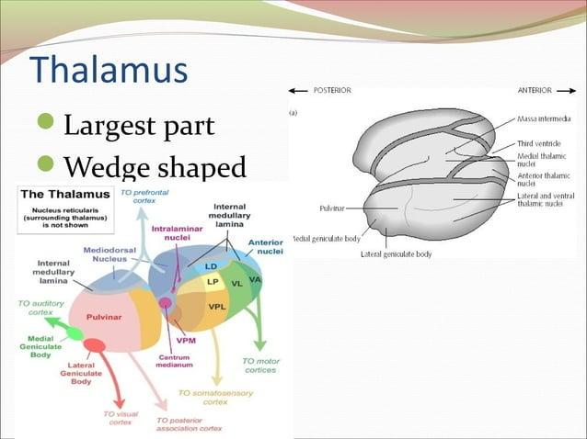

Slide 15
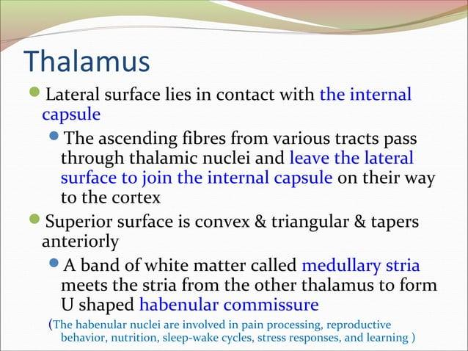

Slide 16
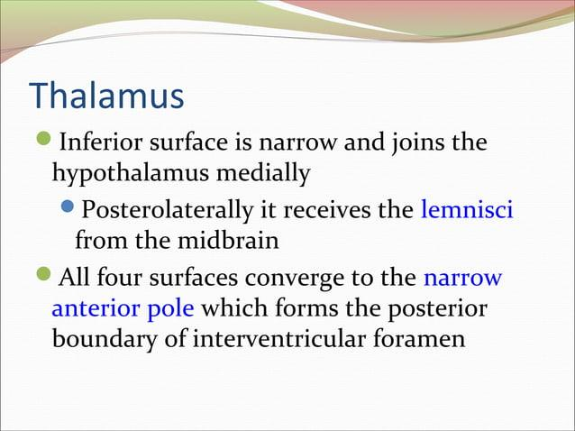

Slide 17
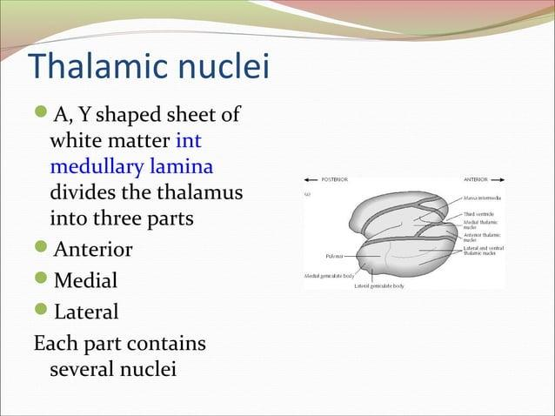

Slide 18
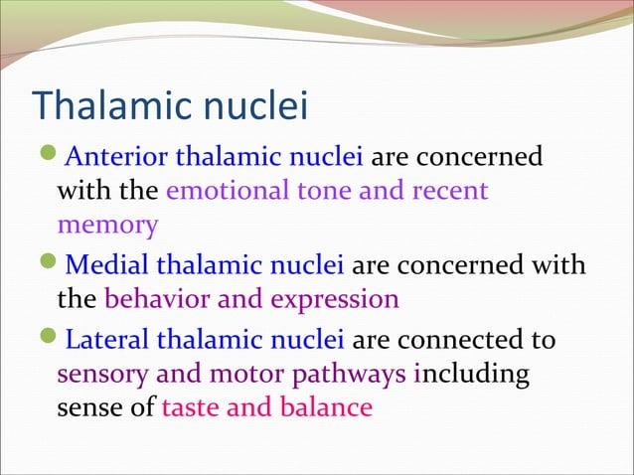

Slide 19
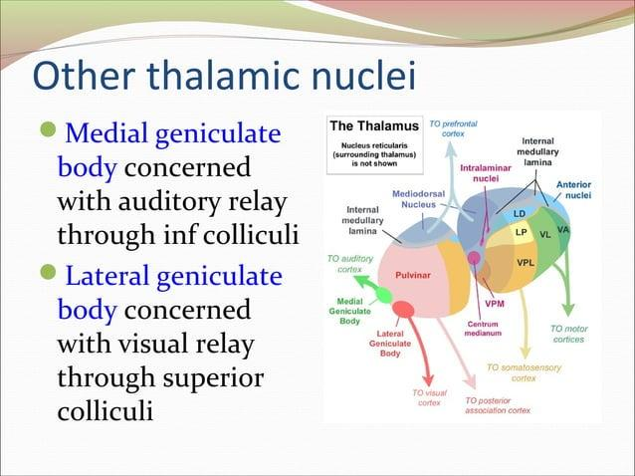

Slide 20
Nuclei
Anterior nuclei | Anteroventral nucleus Anteromedial nucleus Anterodorsal nucleus
Medial nuclei | Dorsomedial nucleus Midline nucleus (median, periventricular)
Lateral nuclei | Dorsal group - Lateral dorsal - Lateral posterior - Pulvinar Ventral group - Ventral anterior - Ventral lateral - Ventral posterior - Ventral posterior medial - Ventral posterior lateral - Ventral posterior inferior Metathalamic nuclei - Medial geniculate nucleus - Lateral geniculate nucleus
Intralaminar nuclei | Centromedian nucleus Parafascicular nucleus
Reticular nucleus | Reticular thalamic nucleus

Slide 21
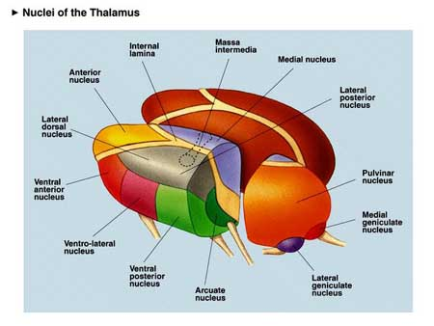
THALAMUS-complex set of subnuclei

Slide 22
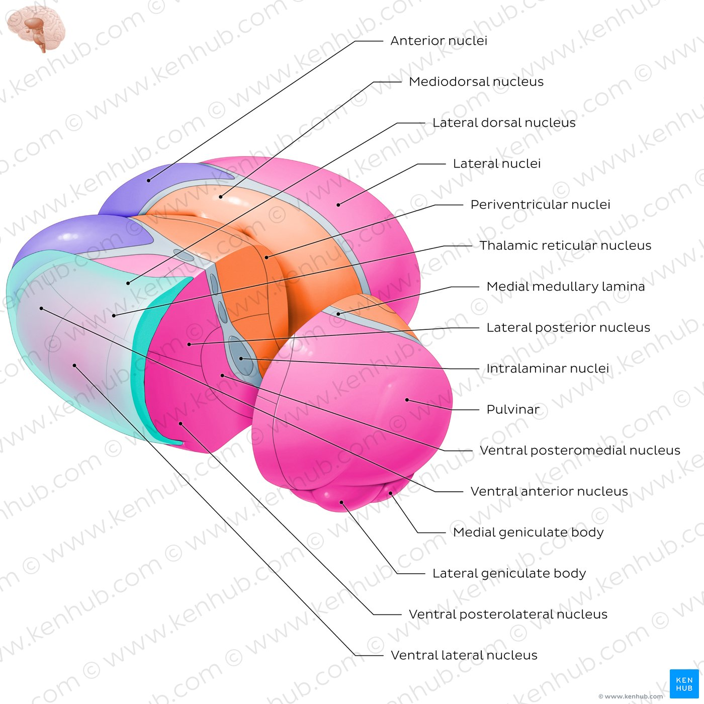
Thalamic nuclei

Slide 23
FUNCTIONAL PATHWAYS OF THE THALAMUS
Sensory pathways (vision, auditory and somatosensation), motor pathways (thalamo-cortico-basal ganglia loop) and others (limbic system etc)
Somatosensory Pathway: Spinothalamic → VPL → Somatosensory Cortex
Visual Pathway: Retina → Lateral Geniculate Body → Occipital Cortex
Auditory Pathway: Inferior Colliculus → Medial Geniculate Body → Temporal Cortex

Slide 24
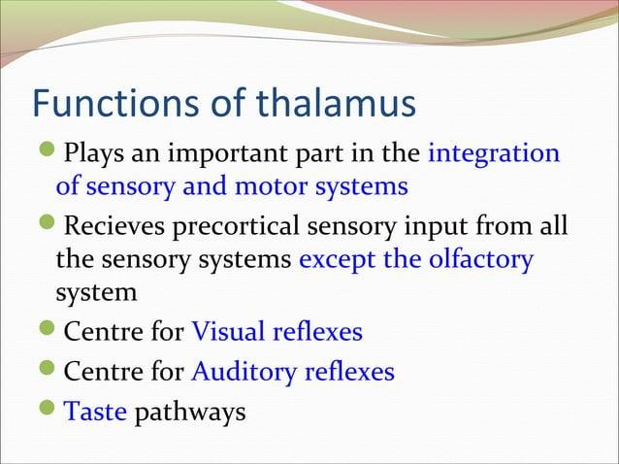

Slide 25
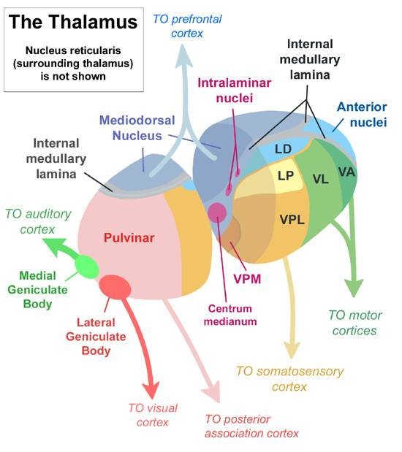
THALAMO-CORTICAL SPECIFICITY

Slide 26
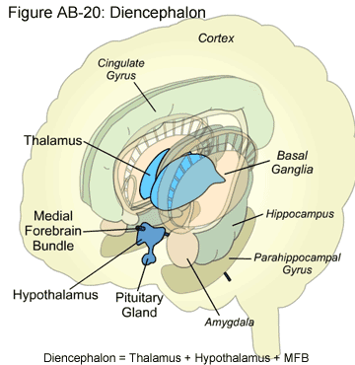
Diencephalon-The Hypothalamus
-slightly anterior to and inferior to the thalamus

Slide 27
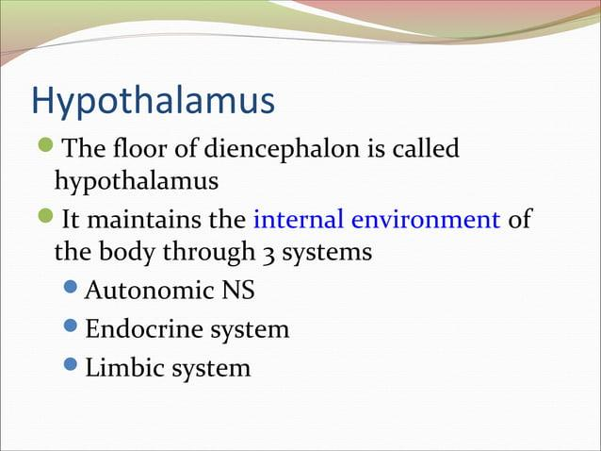

Slide 28
HYPOTHALAMUS: Anatomy and Zones
The hypothalamus can be divided anteroposteriorly into 3 regions:
- anterior (preoptic & supraoptic)
- middle (infundibulo-tuberal)
- posterior (mammillary) regions
And mediolaterally into 3 zones:
- periventricular
- medial
- lateral
Between the medial and lateral zones is a paramedian plane that contains the prominent myelinated fibres of the column of the fornix & the mammillothalamic tract
Key nuclei: Supraoptic, Paraventricular, Ventromedial, Arcuate

Slide 29
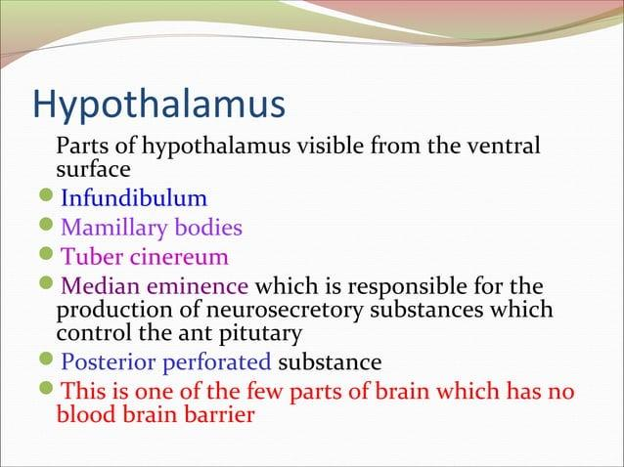

Slide 30
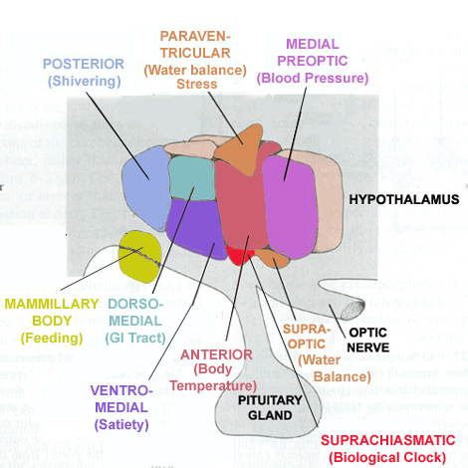
The hypothalamus-subnuclei

Slide 31
Hypothalamic Connections and Pathways
Afferents: Limbic system, Retina, Brainstem
Efferents: Pituitary gland, Autonomic centers, Thalamus
Pathways: Fornix, Mammillothalamic tract, Dorsal longitudinal fasciculus

Slide 32
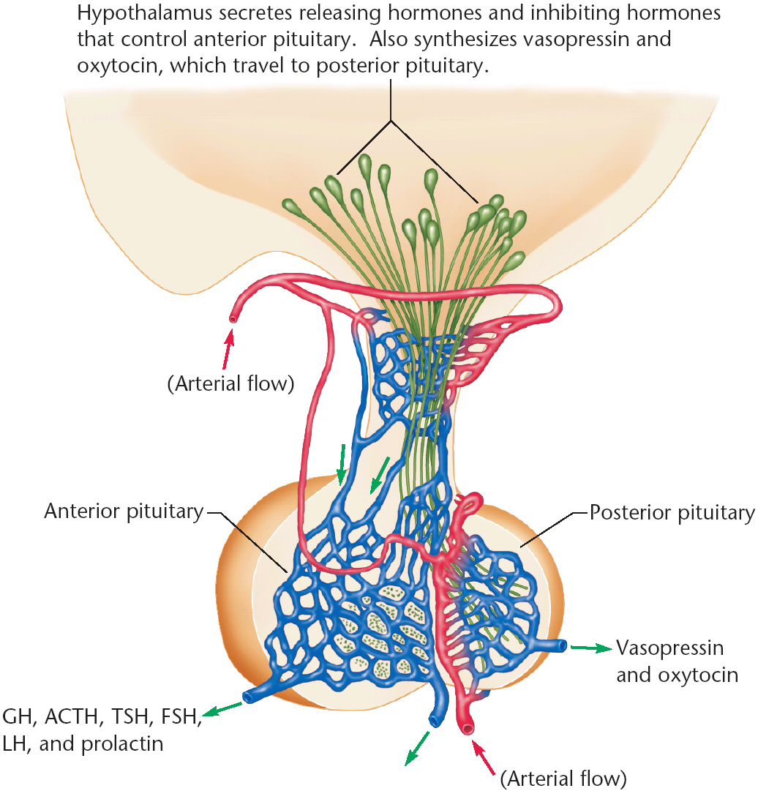
Neuroendocrine axis

Slide 33
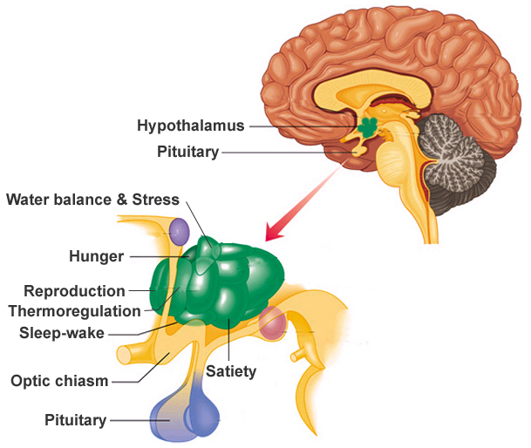

Slide 34
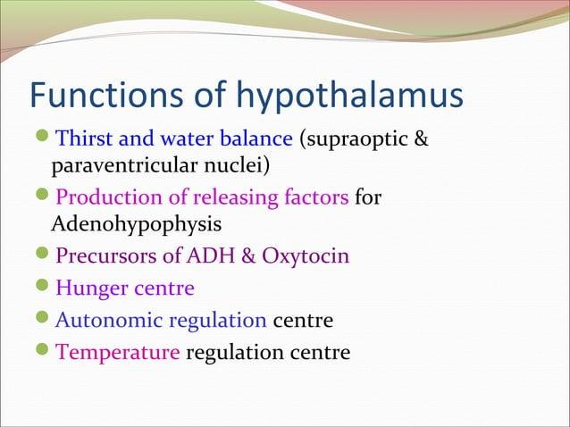

Slide 35
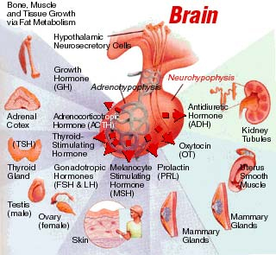
The “master gland”

Slide 36
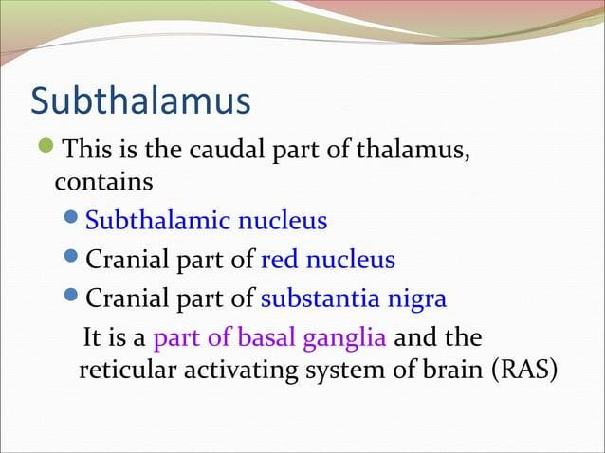

Slide 37
EPITHALAMUS
The epithalamus lies in relation to the posterior part of the roof of the third ventricle and the little adjoining part of its lateral wall. It consists of the following parts:
Stria medullaris
Posterior commissure
Habenular nuclei (medial and lateral)
Pineal body
Paraventricular nuclei (anterior and posterior)

Slide 38
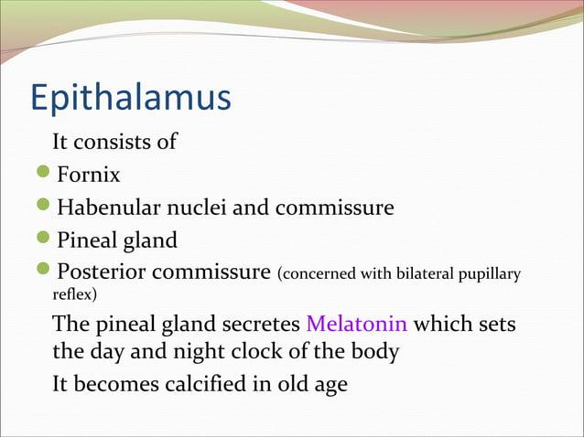

Slide 39
Epithalamus and Subthalamus
Epithalamus: Pineal gland (melatonin secretion), Habenular nuclei (limbic integration)
Subthalamus: Subthalamic nucleus, functionally linked to basal ganglia; lesions cause hemiballismus

Slide 40
BLOOD SUPPLY AND VENOUS DRAINAGE
Arterial supply: Posterior cerebral, Posterior communicating, Anterior choroidal arteries
Venous drainage: Internal cerebral and basal veins

Slide 41
EMBRYOLOGICAL DEVELOPMENT
Derived from prosencephalon (forebrain)
Differentiates into thalamic and hypothalamic regions
Important in organizing cortical-subcortical connections

Slide 42
CLINICAL CORRELATIONS AND IMAGING
Thalamic syndrome: Contralateral sensory loss and pain
Hypothalamic dysfunction: Temperature, appetite, hormonal imbalance
MRI/CT often reveal structural lesions or infarcts

Slide 43
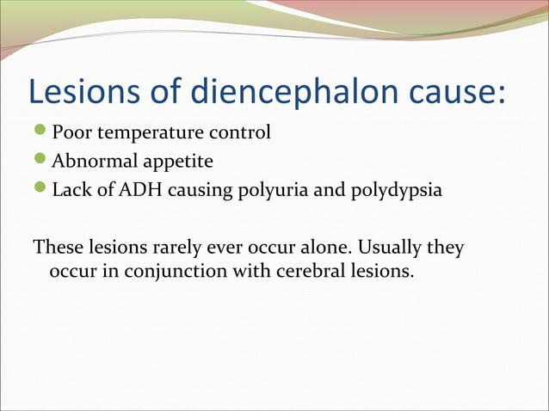

Slide 44
CONCLUSION
The diencephalon is a central integrative hub for sensory, motor, and autonomic functions
Thalamus relays information, hypothalamus regulates homeostasis, epithalamus modulates emotion
Clinical imaging and pathways provide insight into its complexity

Slide 45
THANK YOU

